Slide 1
Design of X band band-stop Frequency Selective Surface
By:
Koustabh Ram Kandula (21BEC0617)
Anurag Sonar (21BEC0496)
Under Guidance of: Prof. Rajesh N (16153)

Slide 2
Contents
Introduction to Frequency Selective Surfaces
Literature Review
Problem Formulation
Relevance
Proposed System
Description
Software Tools
Expected Outcome
Timeline
Summary of Work
Individual Contributions
Reference

Slide 3
Introduction to Frequency Selective Surfaces
Definition: FSS are periodic structures that filter electromagnetic waves by allowing, blocking, or reflecting specific frequencies.
Structure: Made of conductive or dielectric elements (e.g., patches, slots, dipoles) arranged in a periodic pattern.
Function in Antennas: Improve bandwidth and radiation control. Reduce interference and enhance signal quality. Act as spatial filters, reflectors, or radomes.
Applications: Satellite communication and radar systems. Wireless networks and reconfigurable antennas. Electromagnetic shielding and stealth technology.
Advancement: Enables compact, high-performance antennas for modern communication and sensing systems.

Slide 4
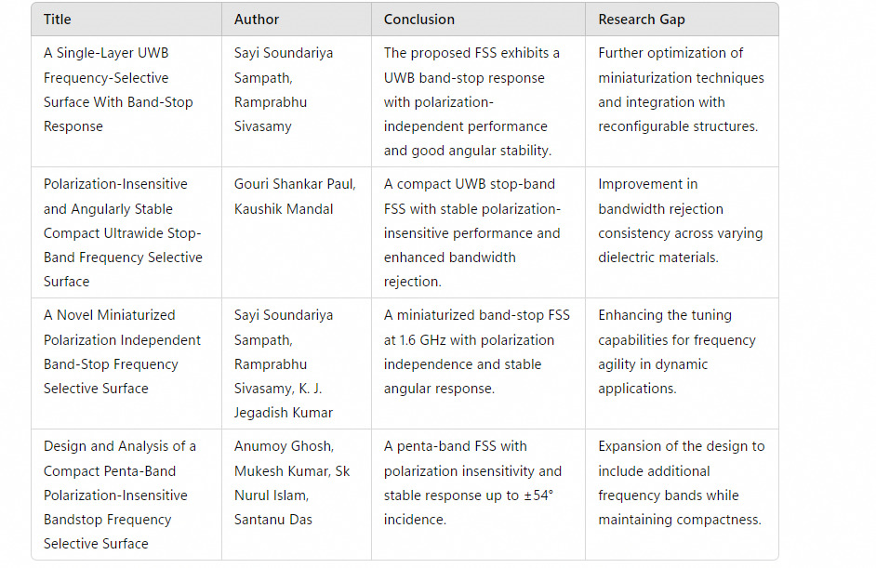
Literature Review

Slide 5
Problem Formulation
Aim:
To Design a Frequency Selective Surface (FSS) to operate within the X-band (8–12 GHz) for applications like radar, satellite communication, and EMI shielding.
Constraints & Design Considerations:
Resonant Frequency: Must lie within 8–12 GHz, tunable via unit cell geometry.
Periodic Structure: Should ensure low transmission loss and high angular stability.
Unit Cell Design: Can use hexagonal loops, Sierpinski gaskets, or other fractal patterns for multi-band operation.
Substrate Selection: Low-loss dielectrics (e.g., FR4,Rogers RT5880) improve efficiency.
Bandwidth & Polarization: Should support broadband response with polarization independence.
Expected Outcome: An optimized FSS structure with high selectivity, low insertion loss, and stable performance across wide angles and polarizations for X-band applications.

Slide 6

Relevance
The design and application of X-band Frequency Selective Surfaces (FSS) align with several United Nations Sustainable Development Goals (SDGs) by enhancing communication systems, radar technologies, and electromagnetic shielding.
X-band FSS is crucial in security and defense applications, enhancing radar stealth, surveillance, and border security systems.
Used in anti-jamming technologies to secure military and civilian communication networks.

Slide 7
Proposed System
Design a hexagonal loop Frequency Selective Surface (FSS) for specific frequency filtering applications, such as band-stop or band-pass responses, tailored to meet targeted performance metrics.
Optimize the loop dimensions and select a suitable dielectric substrate like FR4 to achieve the desired resonant frequency and bandwidth.
Aim for polarization-independent performance and angular stability up to ±60° incidence, ensuring consistent operation across various wave orientations and angles.
Target low insertion loss and high selectivity to enhance the FSS's effectiveness in filtering specific frequency ranges while minimizing signal degradation.

Slide 8
Description
Analytical Description:
Hexagonal loop FSSs consist of periodic arrays of hexagonal metal loops on a dielectric substrate. Their symmetrical design ensures consistent performance.
The loops behave like LC circuits, resonating at specific frequencies. The loop size, spacing, and substrate properties determine the resonant frequency and bandwidth.
They are often polarization-insensitive and maintain stable performance across varying angles of incident waves.

Slide 9
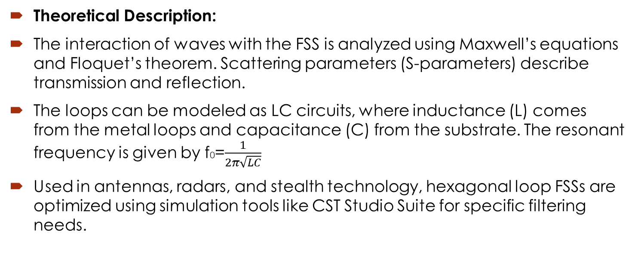
Description Contd.
Theoretical Description:
The interaction of waves with the FSS is analyzed using Maxwell’s equations and Floquet’s theorem. Scattering parameters (S-parameters) describe transmission and reflection.
The loops can be modeled as LC circuits, where inductance (L) comes from the metal loops and capacitance (C) from the substrate. The resonant frequency is given by f0=$\frac{1}{2π\sqrt{LC}}$
Used in antennas, radars, and stealth technology, hexagonal loop FSSs are optimized using simulation tools like CST Studio Suite for specific filtering needs.

Slide 10

Software Tools
Software used: CST Studio Suite
CST Studio Suite is a leading software for 3D electromagnetic simulation, ideal for designing and analyzing Frequency Selective Surfaces (FSS). It provides accurate modeling of electromagnetic wave interactions with FSS structures.
The software offers specialized solvers, such as frequency domain and time domain solvers, which are essential for evaluating the performance of FSS across different frequencies and incident angles.

Slide 11
Expected Outcome
Resonant Frequency: Strong band-stop filtering within the X-band (8–12 GHz), preventing unwanted signal transmission.
High Reflection (S11): Near 0 dB reflection at the stopband frequency, ensuring effective blocking.
Low Transmission (S21): Deep transmission minimal (≤ -20 dB) in the stopband for strong attenuation.
Angular Stability: Consistent performance across a wide range of incident angles due to hexagonal symmetry.
Polarization Independence: Effective for both TE and TM polarized waves, making it versatile for diverse applications.
Compact & Efficient Design: Optimized unit cell size and periodicity (p < λ/2) to minimize diffraction and enhance performance.
Practical Applications: Radar cross-section (RCS) reduction, electromagnetic shielding, and interference mitigation in X-band systems.

Slide 12
Timeline
January
February
March
April
Objective Finalization
Software Selection
Planning
Timeline Creation
Implementation
Structure Simulation
Structure Finalization
Project Report
Results
Faculty Review
Review II
Result Documentation
Final Review

Slide 13
Summary of Work
Decided objective for the project to be Frequency Selective Surfaces.
Found various research papers on FSSs with different Shaped FSS sheets.
Testing of the found FSS structures.
Did literature surveys for Frequency Selective Surfaces

Slide 14
Individual Contribution
Koustabh Ram Kandula
Literature Survey
Structure Simulation
Anurag Sonar
Material Research
Presentation and Documentation

Slide 15
References
[1]S. N. Azemi, K. Ghorbani, and W. S. T. Rowe, “3D frequency selectivesurface with incident angle independence,” in Proc. Eur. Microw. Conf.,Nuremberg, Germany, 2013, pp. 928–931.
[2] M. H. Nisanci et al., “Experimental validation of a 3D FSS designed byperiodic conductive fibers Part-1: Band-pass filter characteristic,” IEEETrans. Electromagn. Compat., vol. 59, no. 6, pp. 1841–1847, Dec. 2017.
[3] M. H. Nisanci et al., “Experimental validation of a 3D FSS designedby periodic conductive fibers Part-2: Band-stop filter characteristic,”IEEE Trans. Electromagn. Compat., vol. 59, no. 6, pp. 1835–1840,Dec. 2017.
[4] M. Bouslama, M. Traii, A. Gharsallah, and T. A. Denidni, “Reconfigurabledual-band 3D frequency selective surface unit-cell,” in Proc. IEEE Int.Symp. Antennas Propag. USNC/URSI Nat. Radio Sci. Meeting, Vancouver,BC, Canada, 2015, pp. 1264–1265.
[5] M. H. Nisanci, A. Y. Tesneli, N. B. Tesneli, and E. Tek, “Parameter analysisof a novel single layer 3D band-pass FSS designed by combination of con-tinuous and discontinuous conductive rods,” in Proc. Prog. Electromagn.Res. Symp., Shanghai, China, 2016, pp. 3329–3332.
[6] B. A. Munk, Frequency Selective Surfaces: Theory and Design. New York,NY, USA: Wiley, 2000.
[7] Q. Luo, S. Gao, M. Sobhy, and X. Yang, “Wideband transmitarray withreduced profile,” IEEE Antennas Wireless Propag. Lett., vol. 17, no. 3,pp. 450–453, Mar. 2018
[8]B. Hua, X. He, and Y. Yang, “Polarisation-independent UWB frequencyselective surface based on 2.5D miniaturised hexagonal ring,” Electron.Lett., vol. 53, no. 23, pp. 1502–1504, Nov. 2017.
[9] S. Ghosh and K. V. Srivastava, “A polarization-independent broadbandmultilayer switchable absorber using active frequency selective sur-face,” IEEE Antennas Wireless Propag. Lett., vol. 16, pp. 3147–3150,2017.
[10] J. Li et al., “Design of a tunable low-frequency and broadband radarabsorber based on active frequency selective surface,” IEEE AntennasWireless Propag. Lett., vol. 15, pp. 774–777, 2016.

